Slide 1
Overview of Green Plant Phylogeny
The Big Picture
Judd et al pp. 157-187

Slide 2
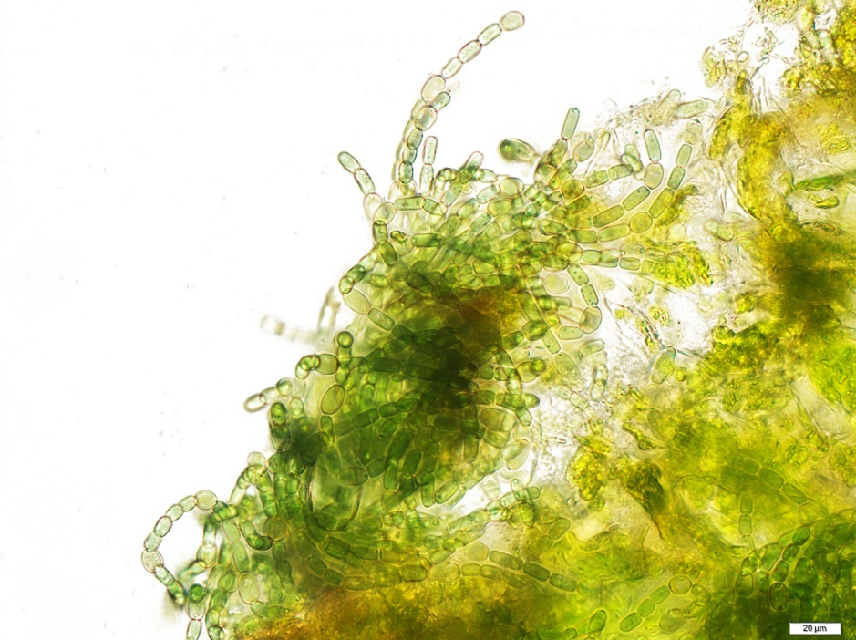
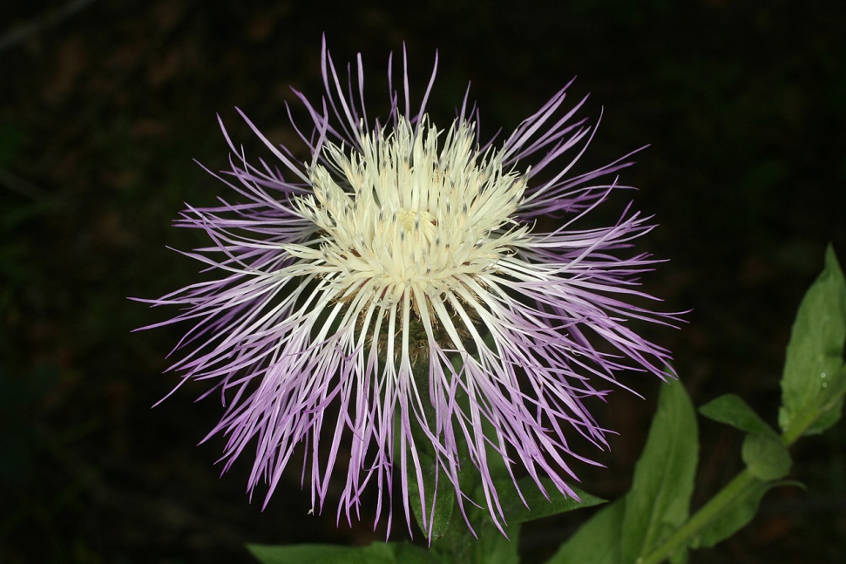
How Did We Get…
From this…
To this…?
Anabaena azollae (cyanobacterium)
Plectocephalus rothrockii (Asteraceae)

Slide 3
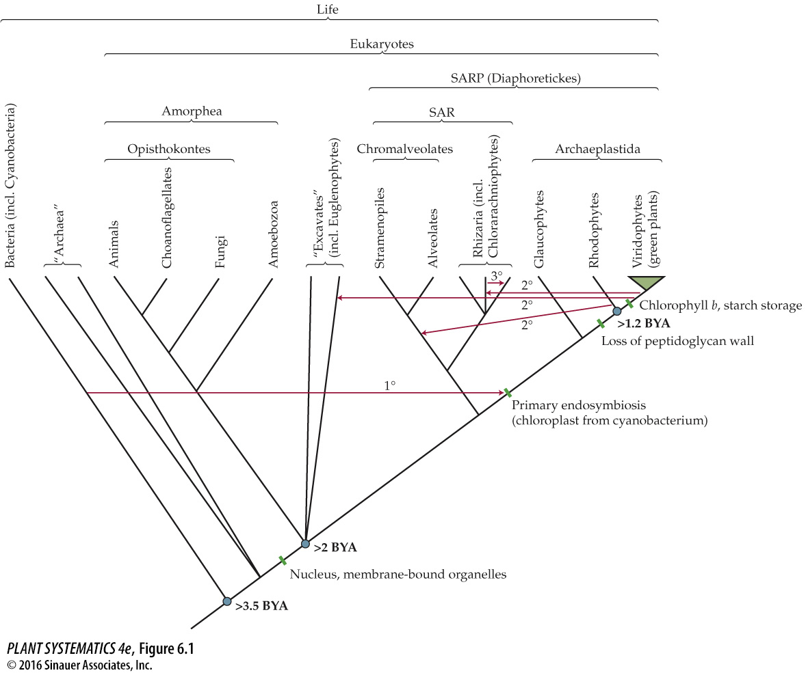
All photosynthetic
oxygen evolving
organisms have
chlorophyll a. Cyanobacteria have Chlorophyll a and other pigments called phycobilins
Leads to first chloroplasts.

Slide 4
Earth born
Bacteria appear
First flowering plants
First plants– “green algae”
First land plants (liverworts)
4.54 Billion years ago
1 Billion years ago
140 Million years ago
>3.5 Billion years ago
450 Million years ago
For comparison, first Homo sapiens appeared about 150,000 years ago!

Slide 5
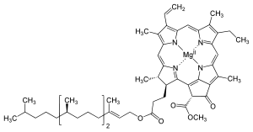
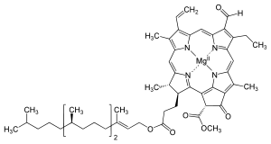
Viridophytes (Green Plants) gain Chlorophyll b (no phycobilins)
Chlorophyll a (universal)
Chlorophyll b

Slide 6
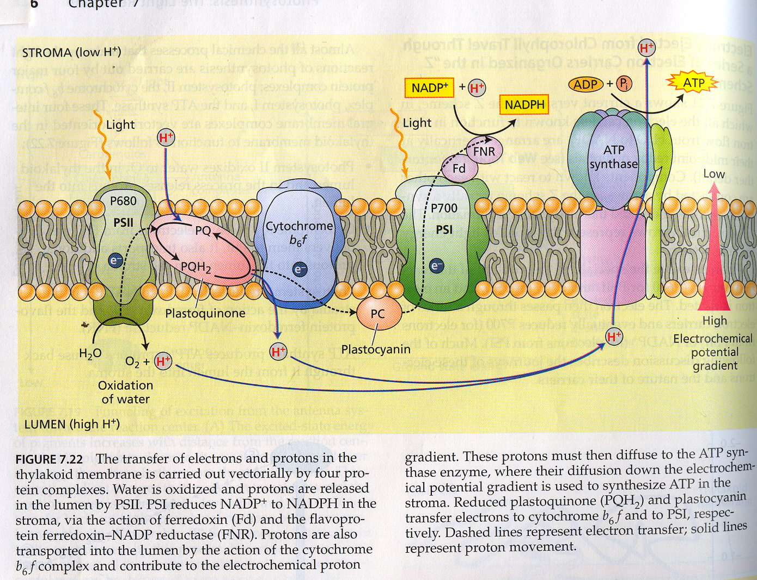
Light Reactions

Slide 7
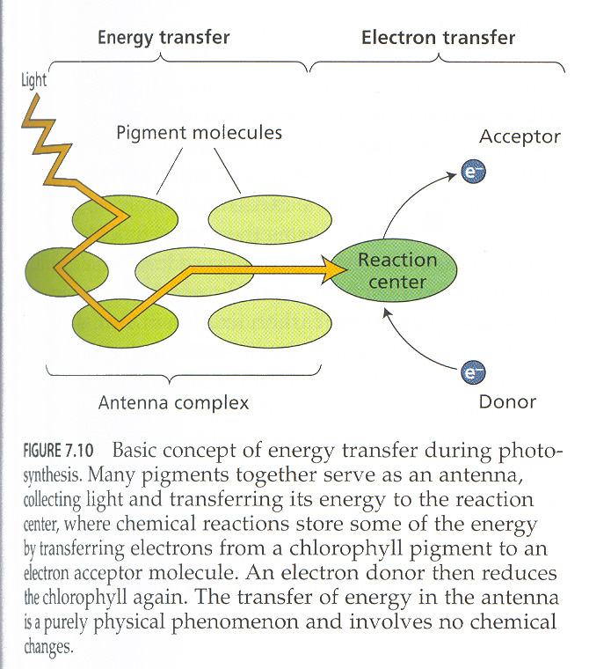
Reaction Center and Antenna Pigments

Slide 8
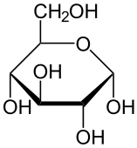
Alpha-d-glucose
The “d” stereoisomer is the naturally occuring form. Alpha refers to the down position of the hydroxyl group on carbon 1.

Slide 9
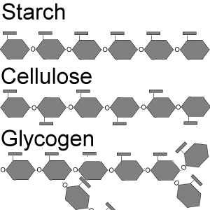
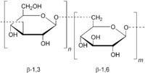
Polysaccharides
Starch (Green Plants or Viridophytes)
Seaweeds
Laminarin (beta 1-3 and beta 1-6 linked polysaccharide)
Alpha 1-4 linkage
Structural, beta 1-4
animals

Slide 10
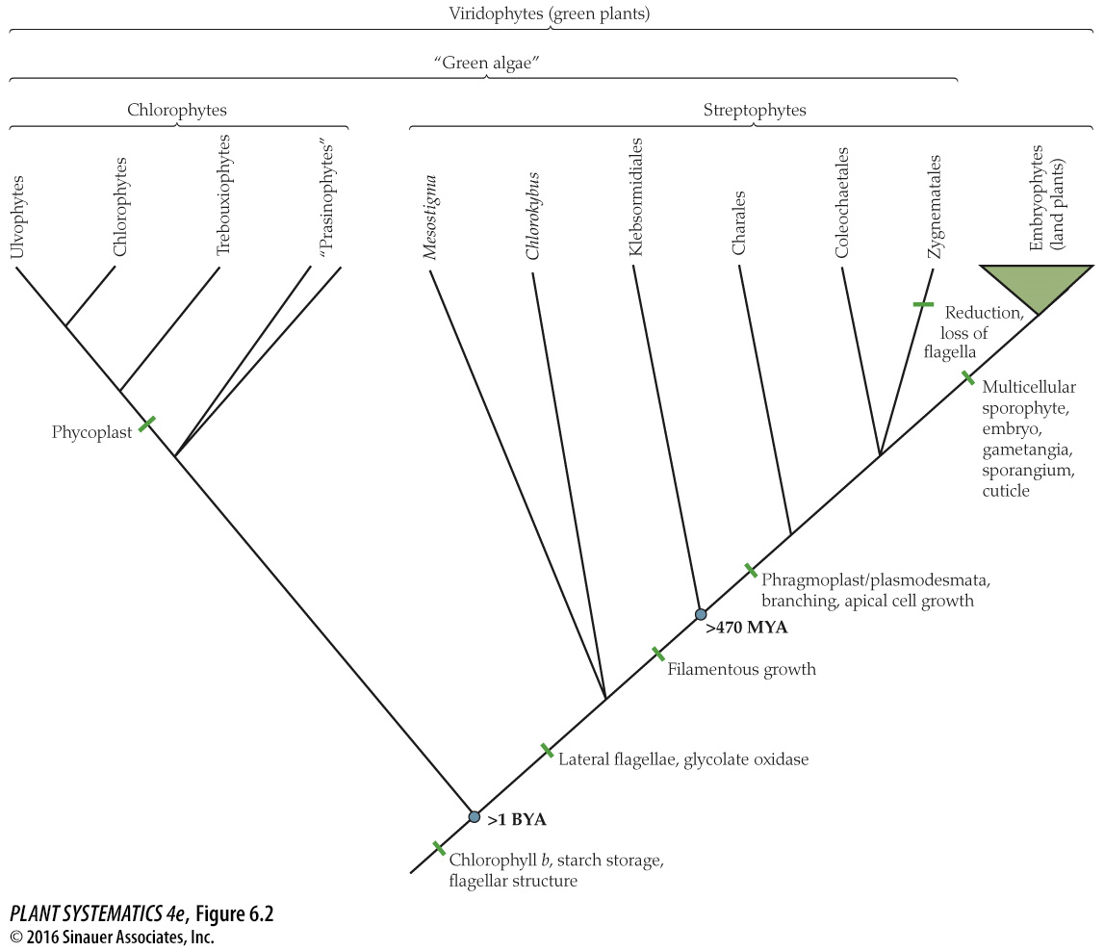
Structure formed during cytokinesis (cell division)
The Transition to Land
To deal with oxygen, and flavonoids to deal with UV radiation

Slide 11
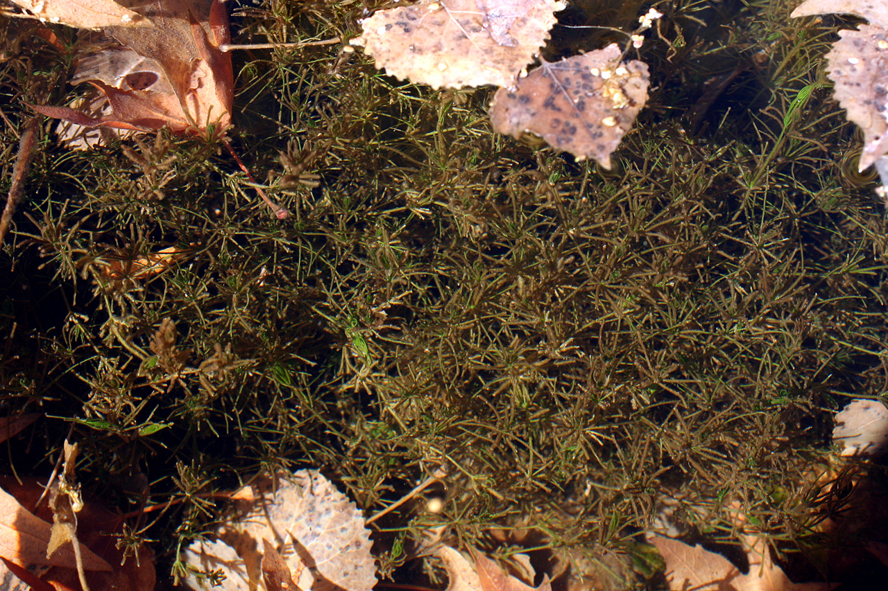
Chara– a green alga

Slide 12
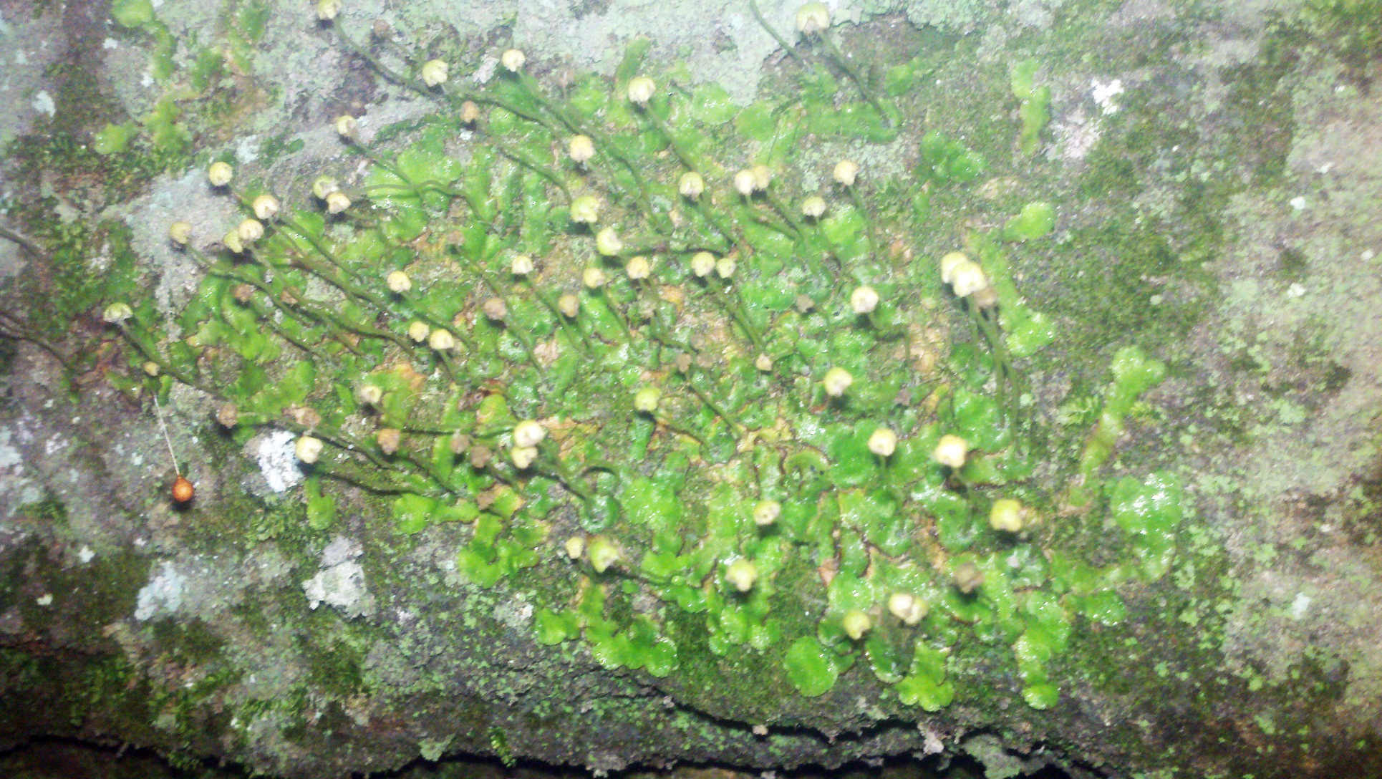
Multicellular Sporophyte– Liverworts

Slide 13
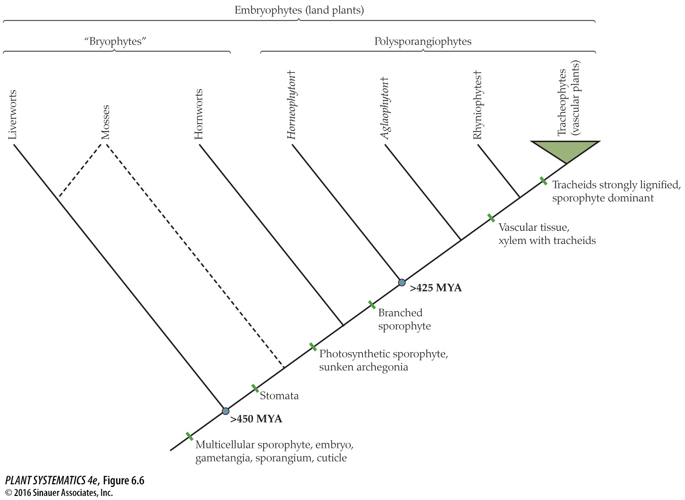
Note polyphyletic nature of “bryophytes” in this tree, but most recent data (2018) accepts a monophyletic bryophyte clade

Slide 14
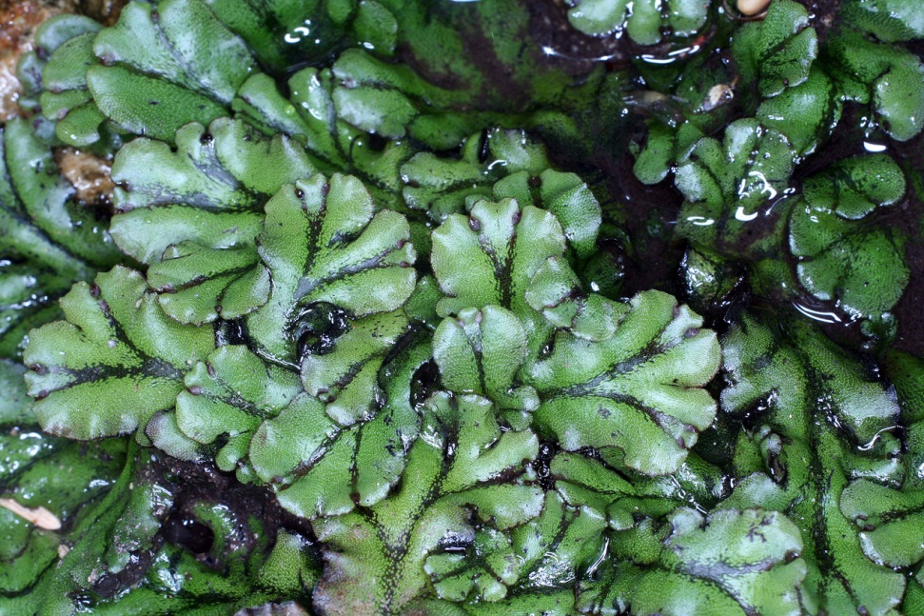
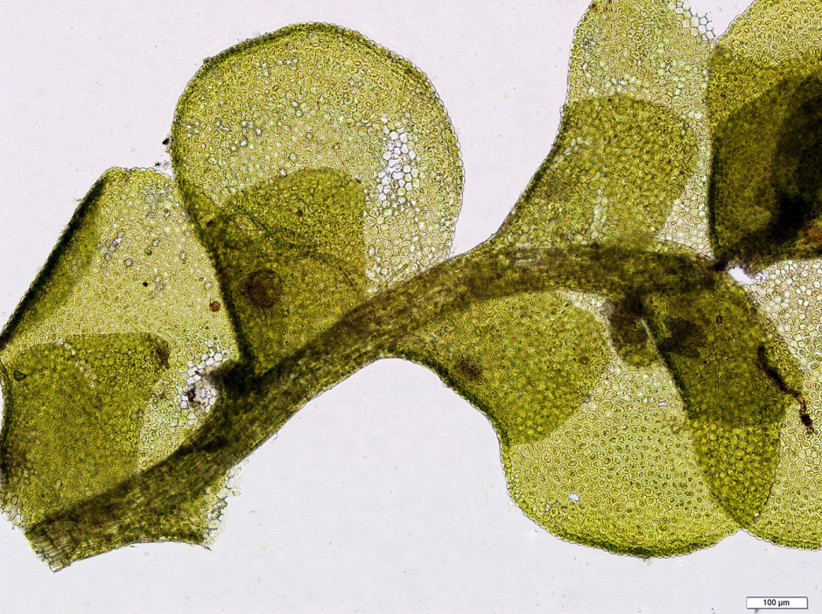
Liverworts
Thallose liverwort-- Marchantia
Leafy liverwort-- Radula

Slide 15
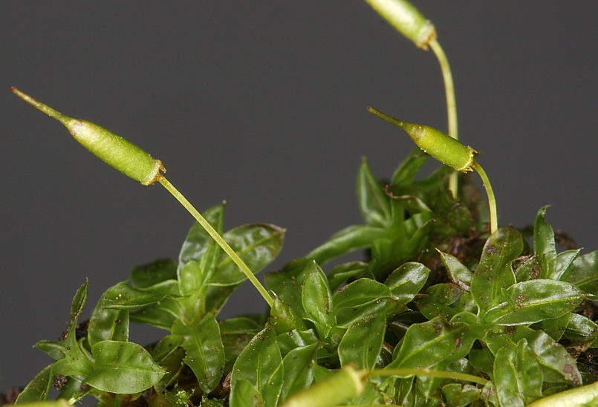
Mosses

Slide 16
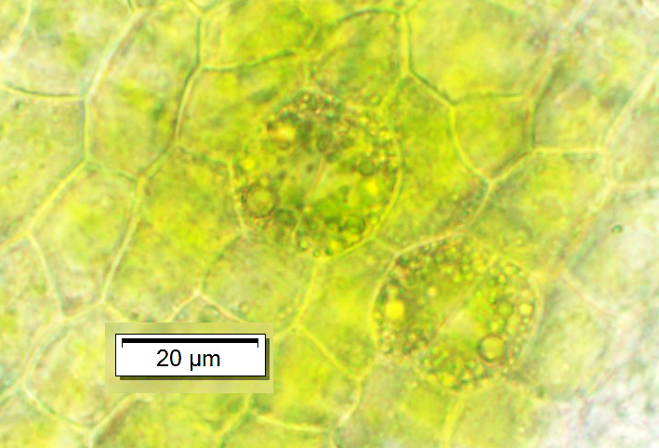
Stomata– Orthotrichum rupestre (moss)

Slide 17
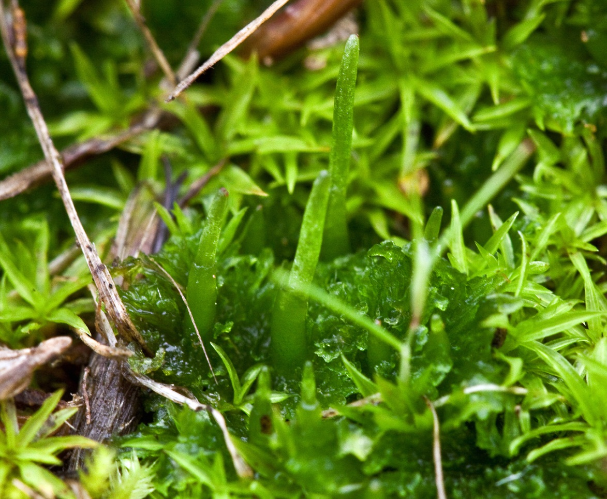
Hornworts– note persistently green sporophyte

Slide 18
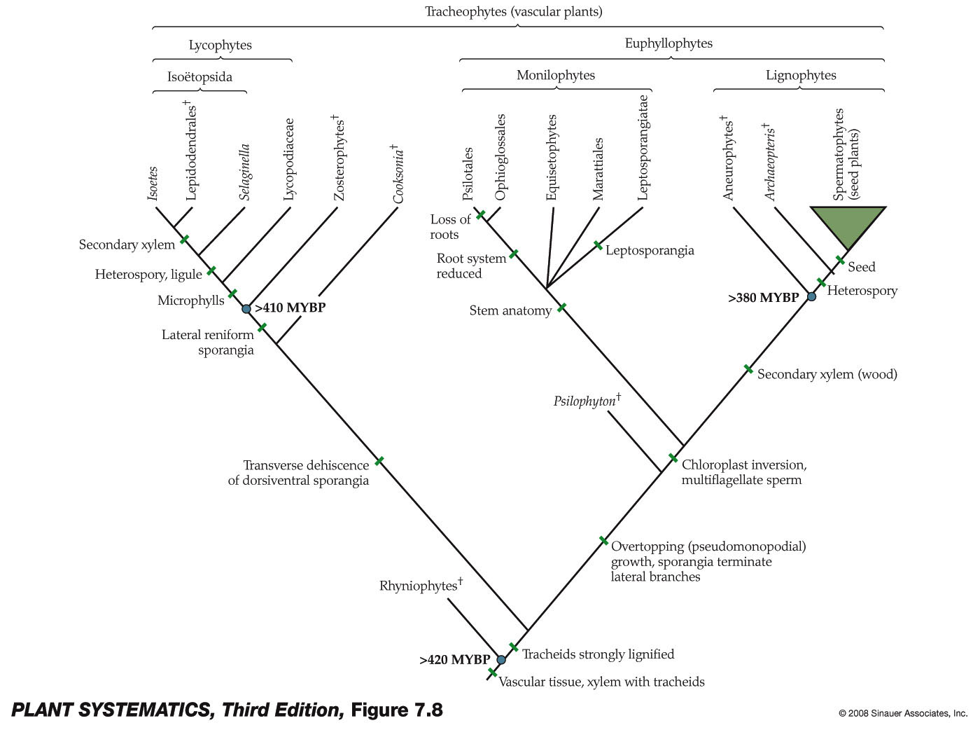
= development of main axis & side branches

Slide 19
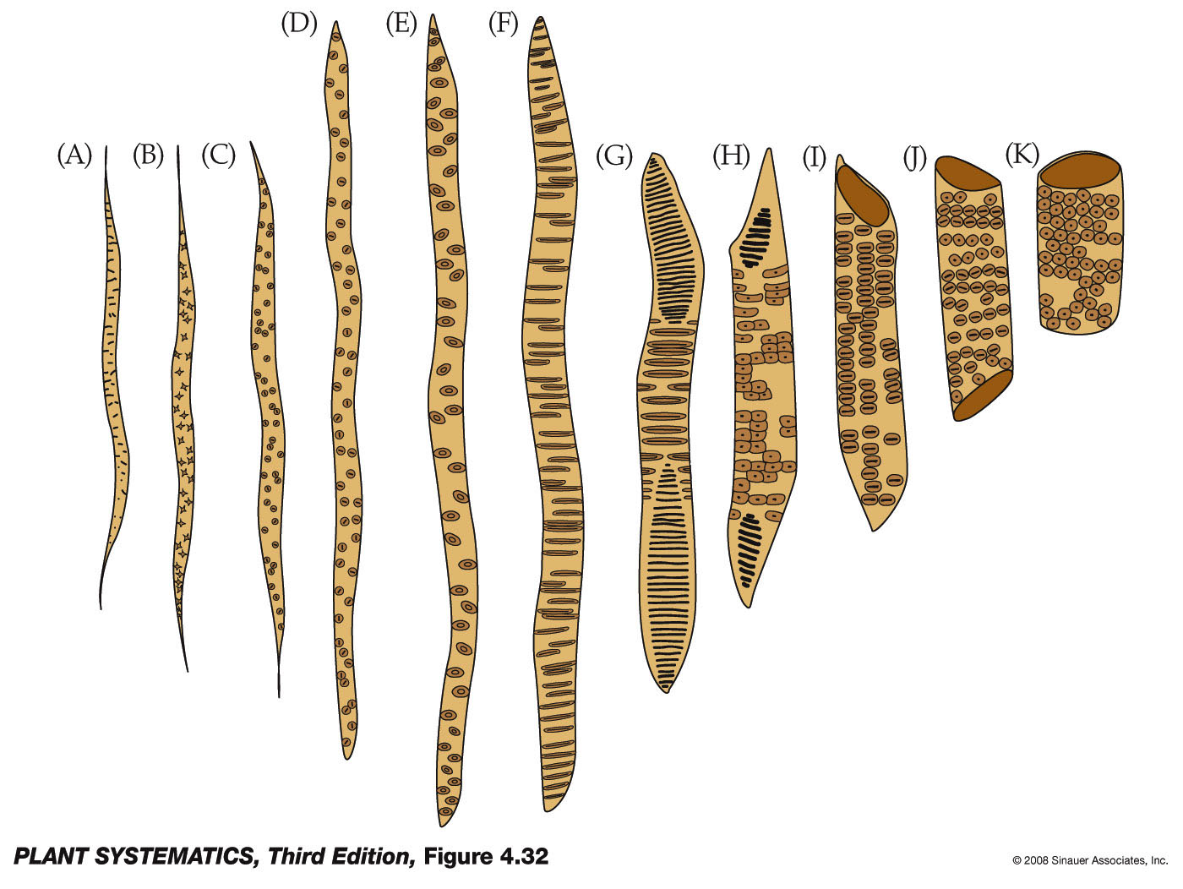
Xylem is formed from tracheids and vessel elements
tracheids
Vessel elements

Slide 20
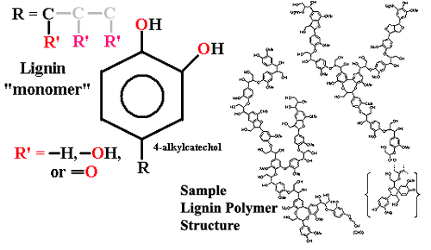
Lignin

Slide 21
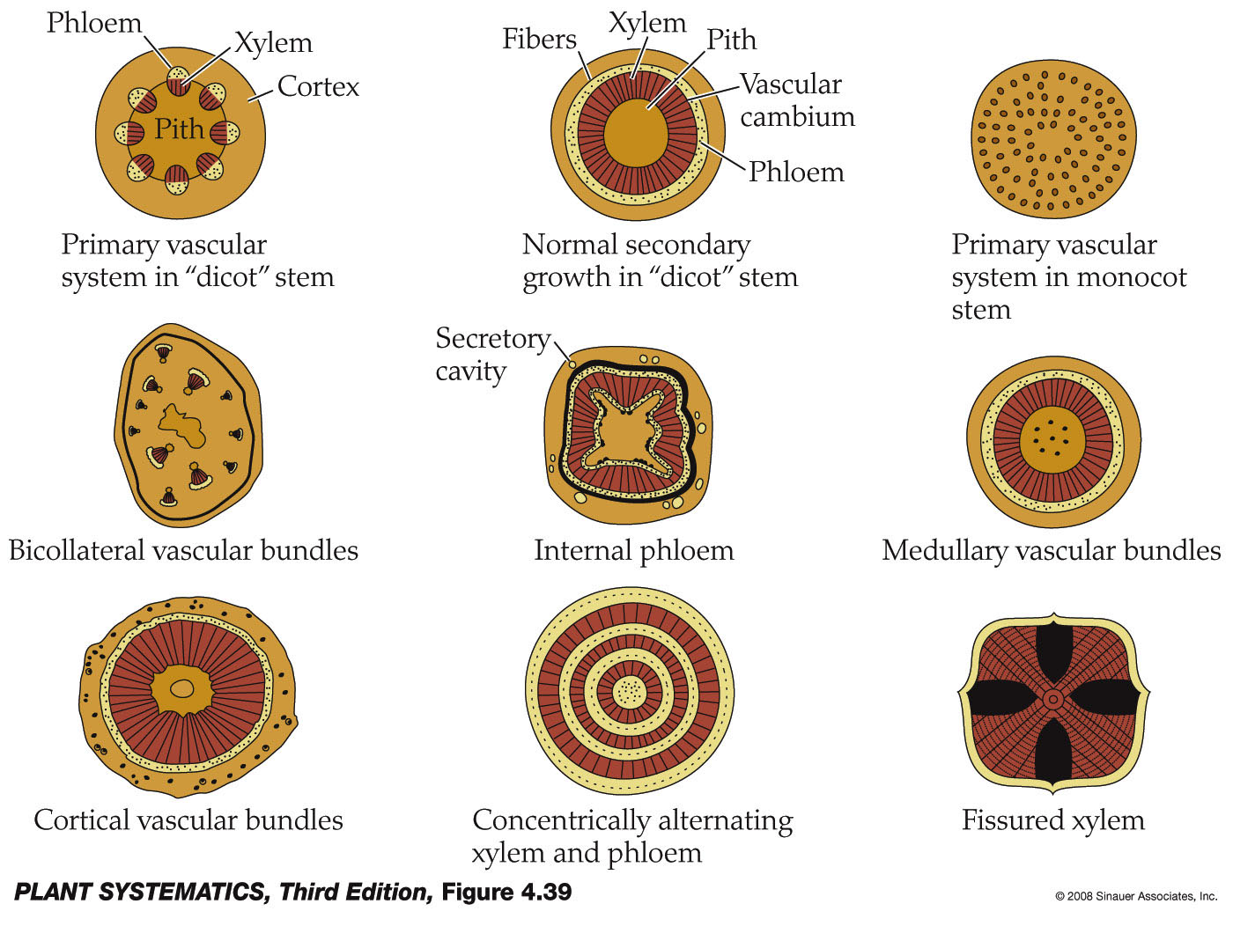
Primary and Secondary Xylem: Vascular Cambium

Slide 22
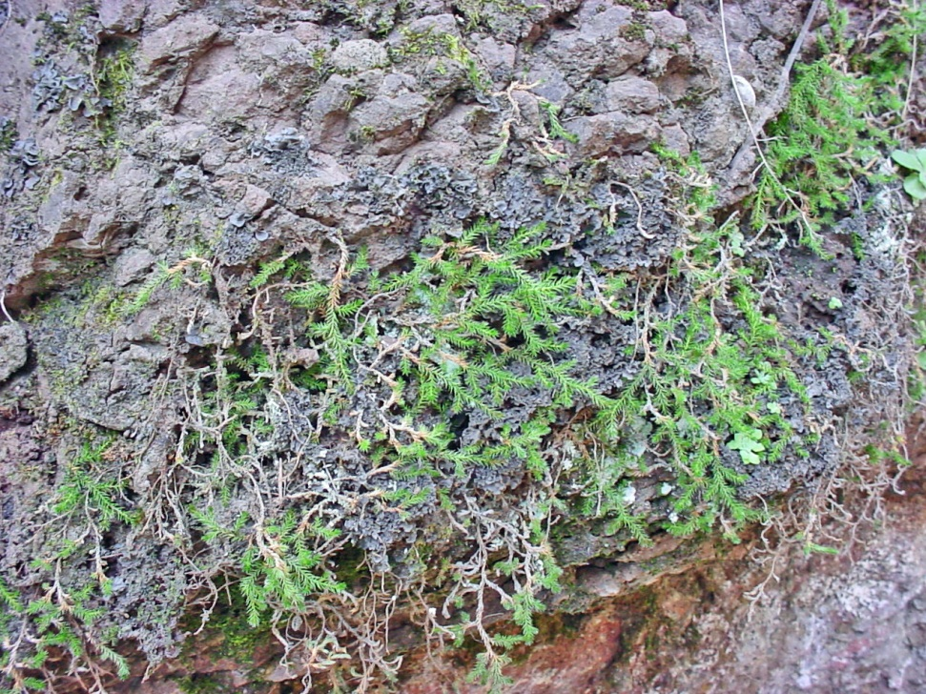
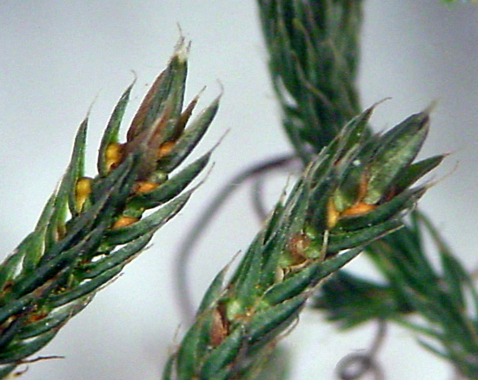
Lycophytes– Selaginella underwoodii
Growth habit
Sporangia in leaf axils

Slide 23
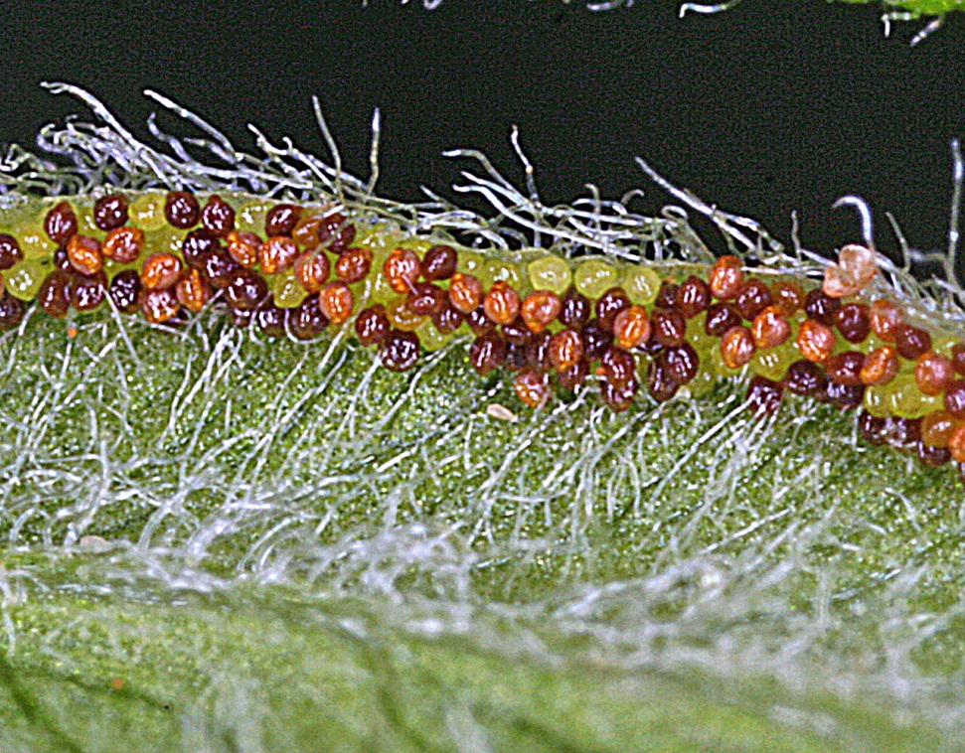
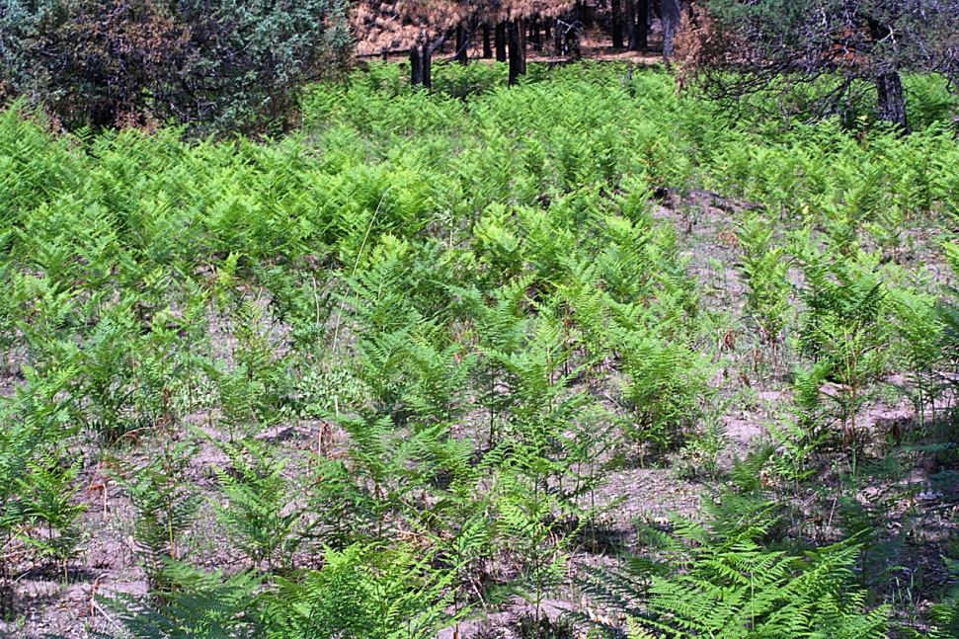
Ferns
Pteridium aquilinum
Sporangia

Slide 24
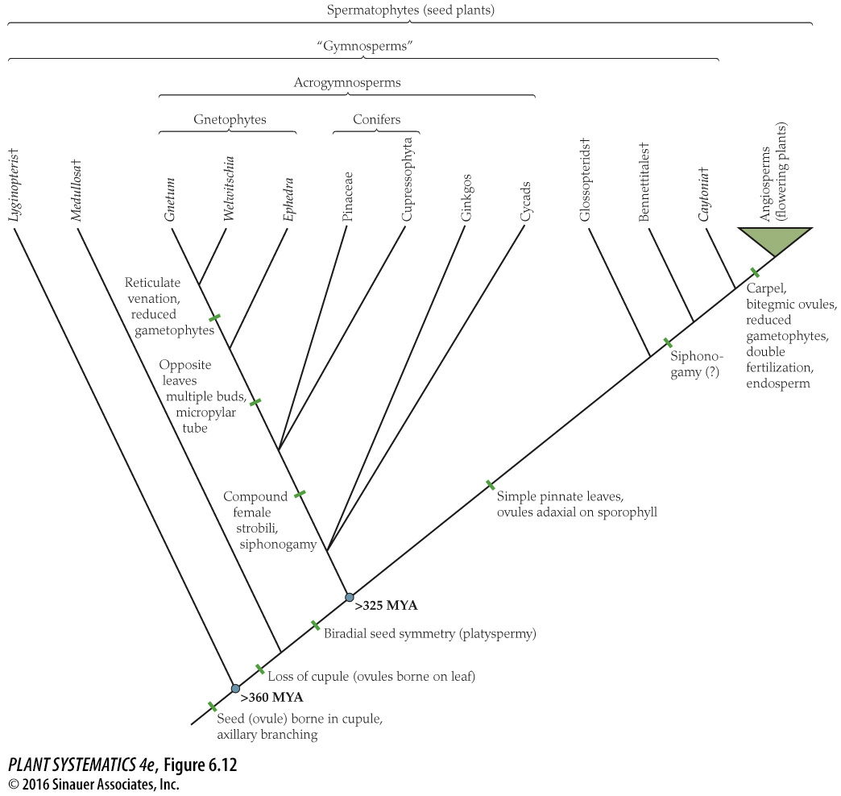
Extinct polyphyletic
taxa within “Gymnosperms”

Slide 25
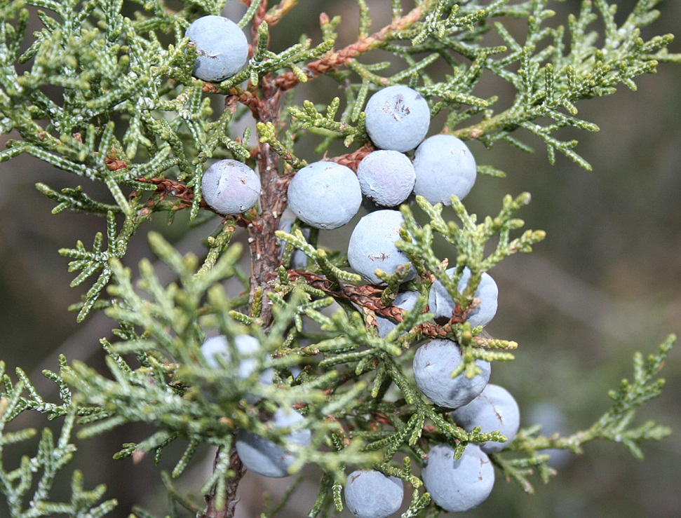
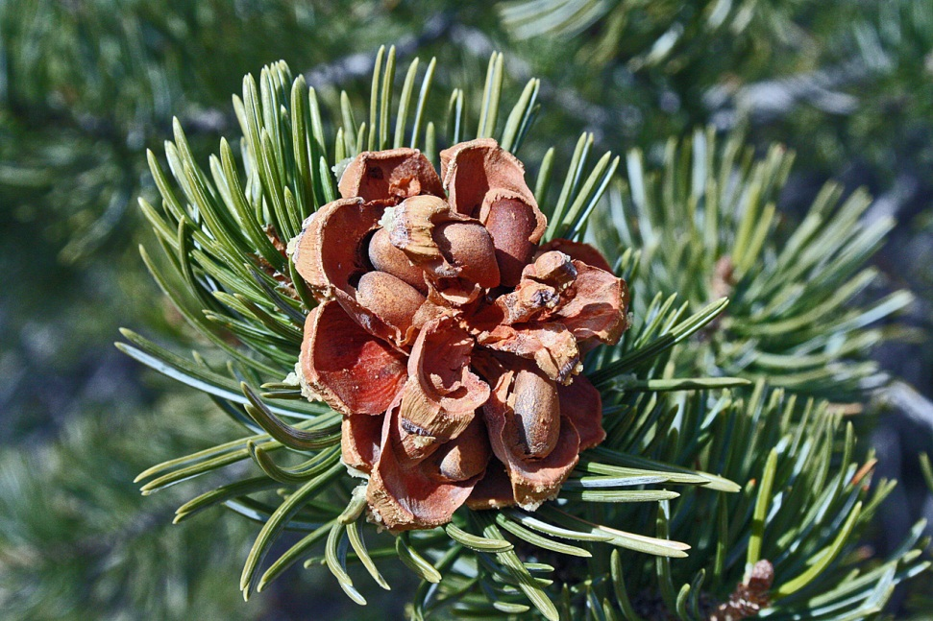
Acrogymnosperms-- conifers
Pinus edulis
Juniperus osteosperma

Slide 26
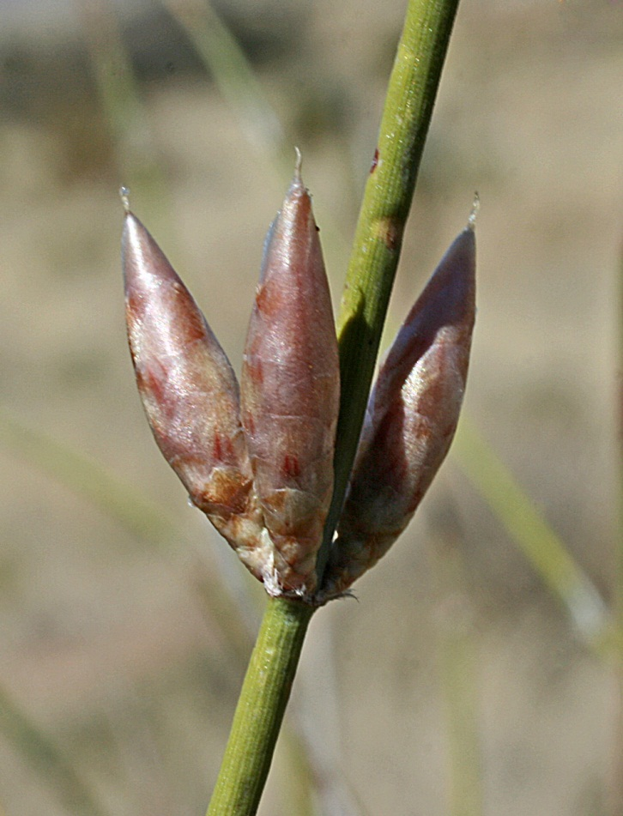
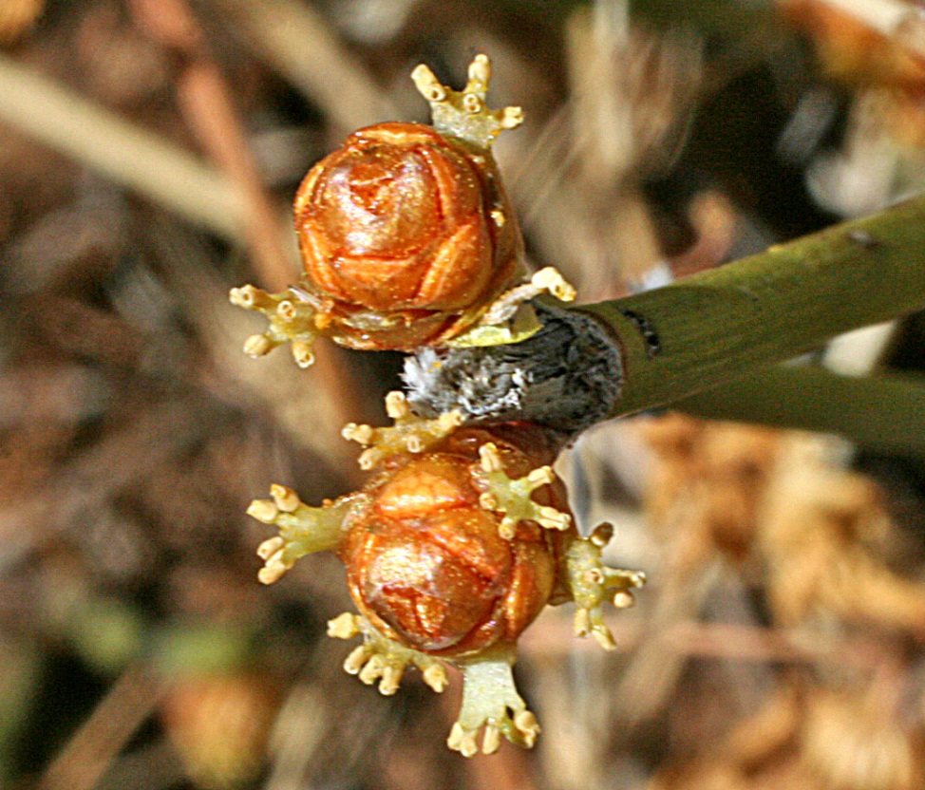
Acrogymnosperms-- Gnetophytes
Ephedra trifurca– pollen strobili
Ephedra trifurca– ovulate strobili

Slide 27
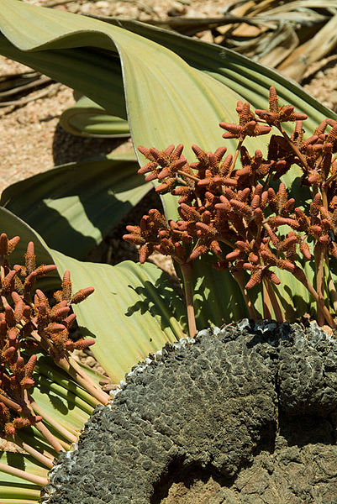
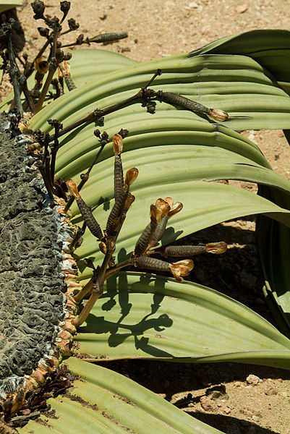
Acrogymnosperms-- Gnetophytes
Welwitchia mirabilis– ovulate plant
Welwitchia mirabilis– pollen plant

Slide 28
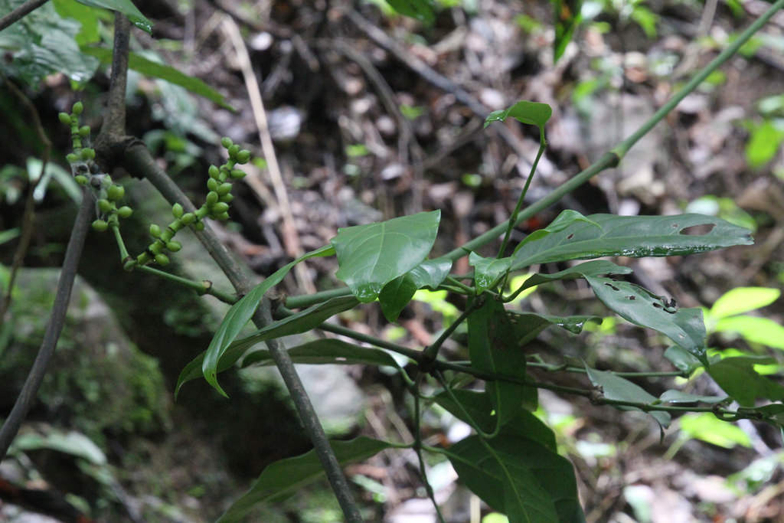
Acrogymnosperms-- Gnetum
A genus of tropical evergreen trees, shrubs and vines

Slide 29
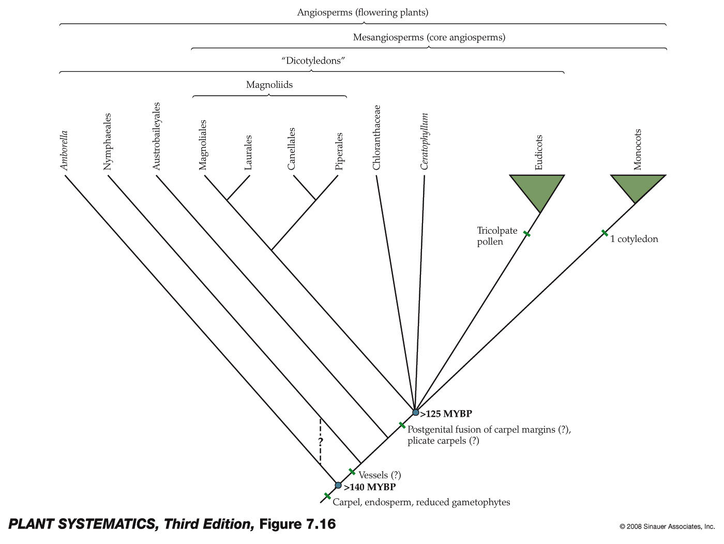
ANA Grade

Slide 30
Many Angiosperm Synapomorphies
Seed produced within a carpel with a stigmatic surface for pollen germination
Very reduced female gametophyte, usually just seven cells
Double fertilization
Triploid endosperm
Fruit– seed within mature ovary

Slide 31
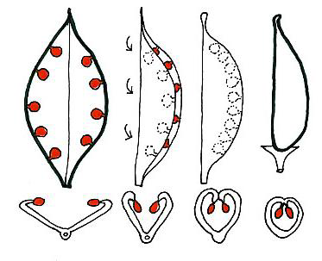
Evolution of the Carpel
(One Hypothesis)

Slide 32
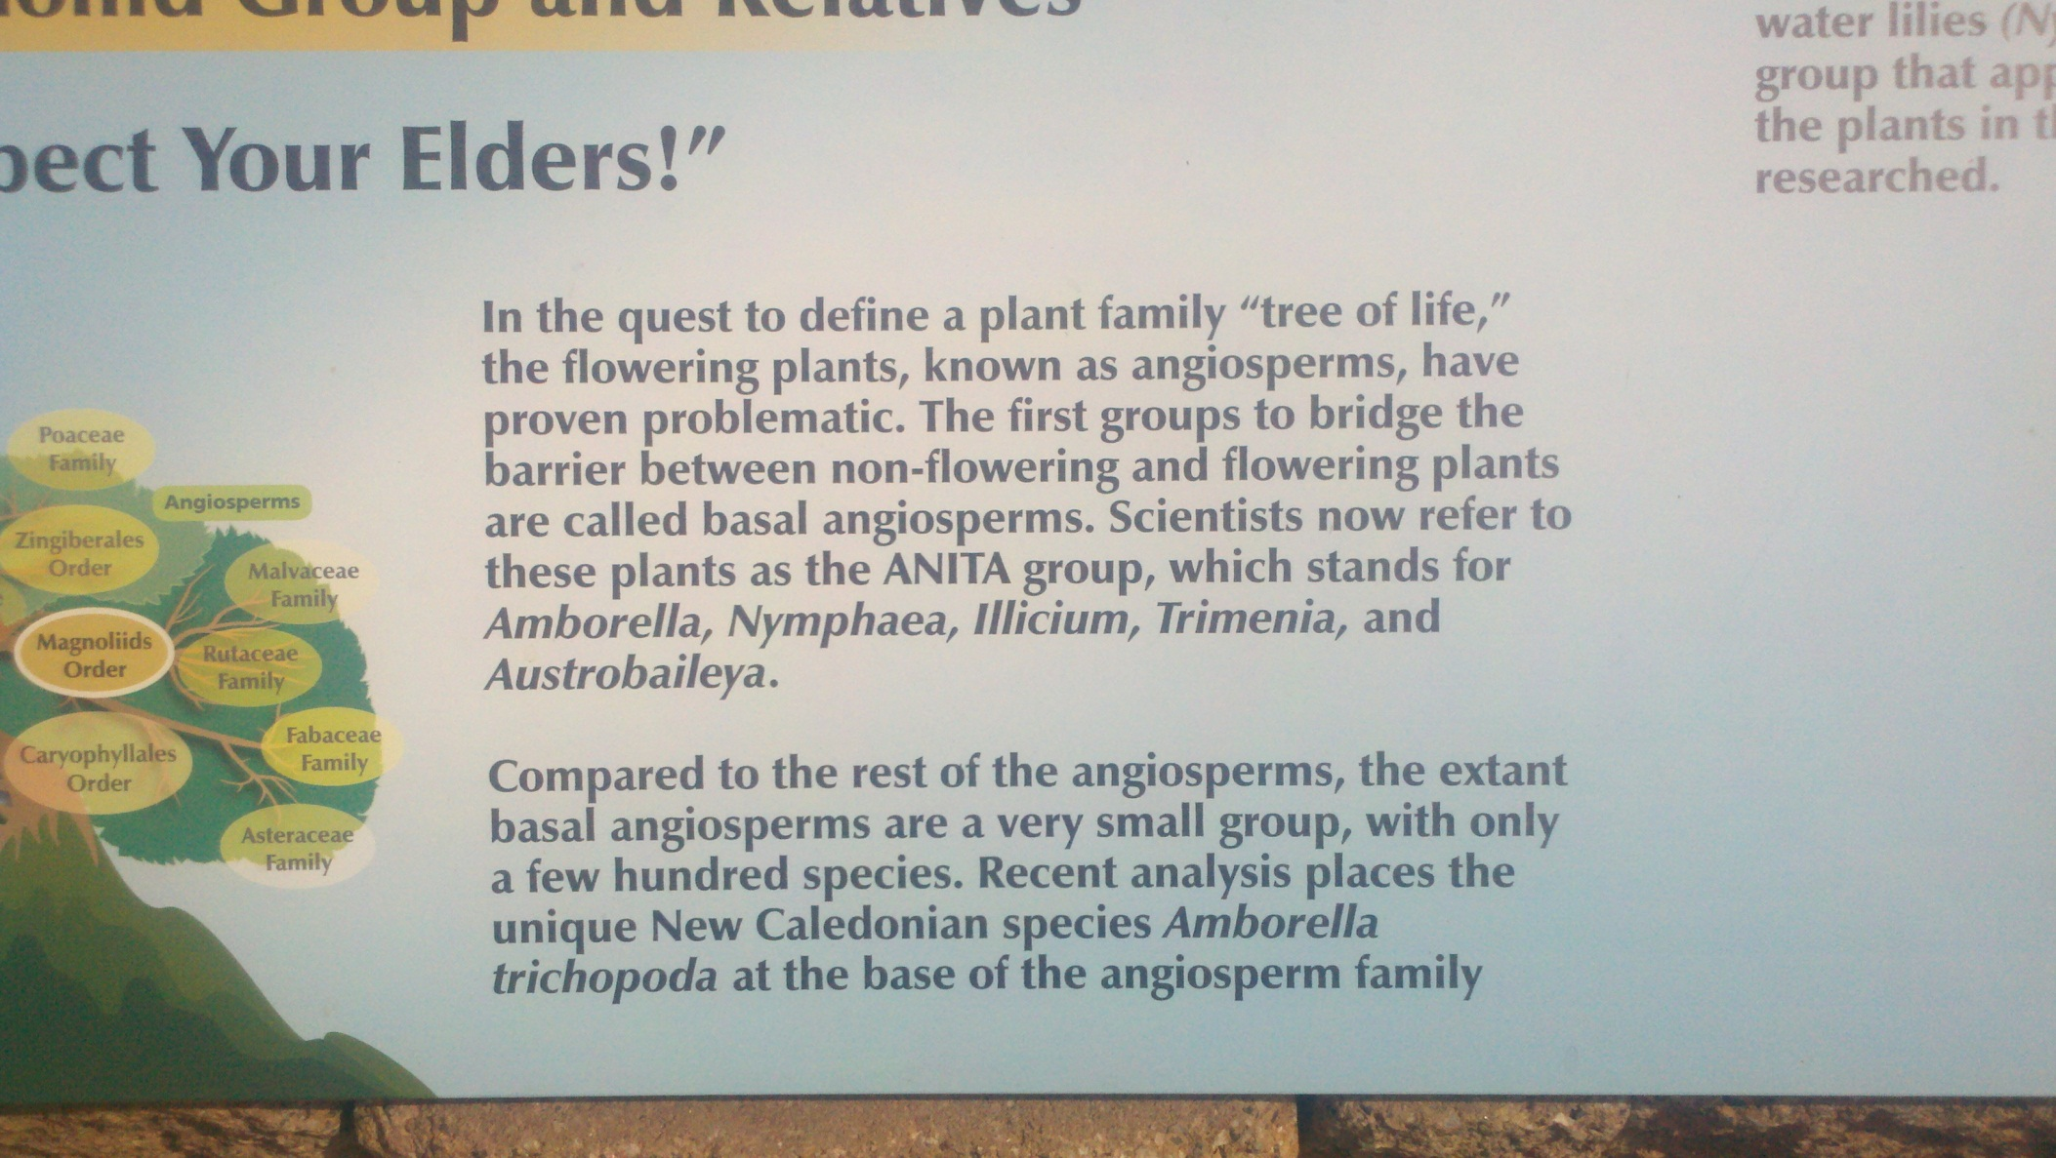
ANA Grade

Slide 33
ANA Grade
Basal Angiosperms
Trend from Apocarpic to Syncarpic
Trend from poorly differentiated filaments and anthers to better differentiated
Trend from poorly differentiated style and stigma to better differentiated

Slide 34
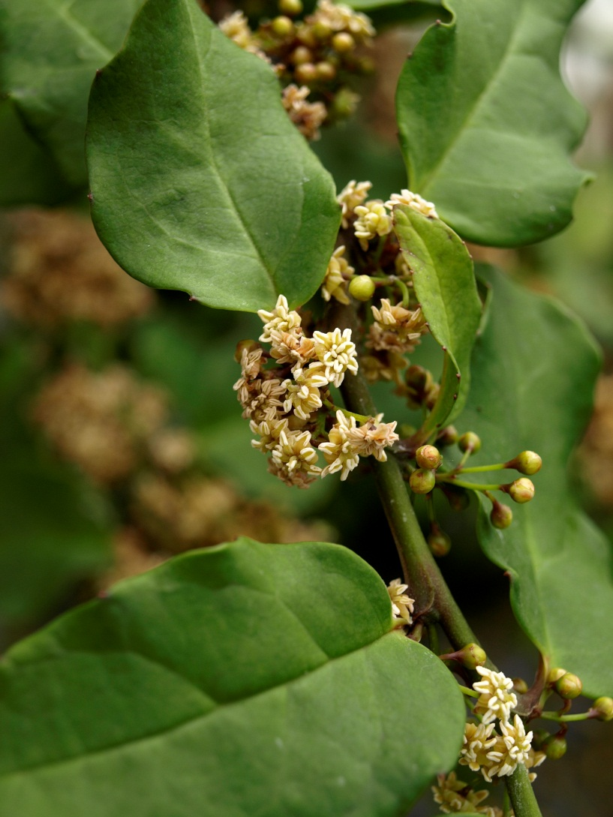
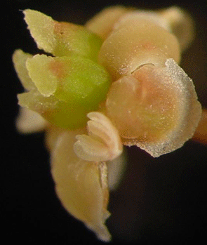
Amborella trichopoda

Slide 35
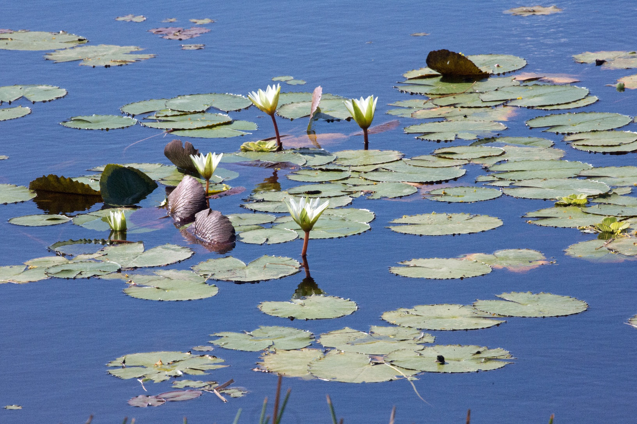
Nymphaeales– the water lilies

Slide 36
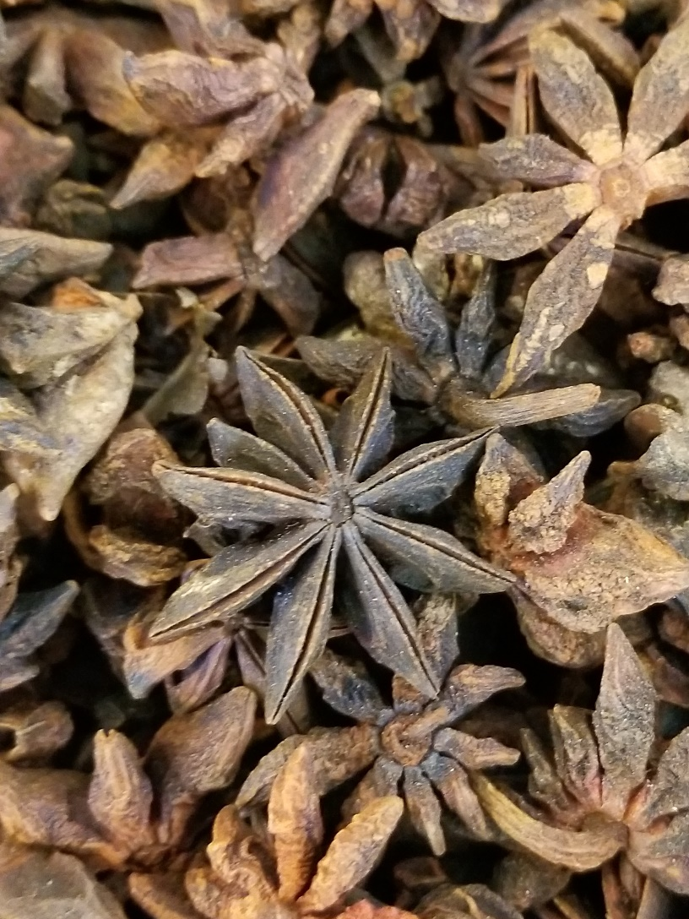
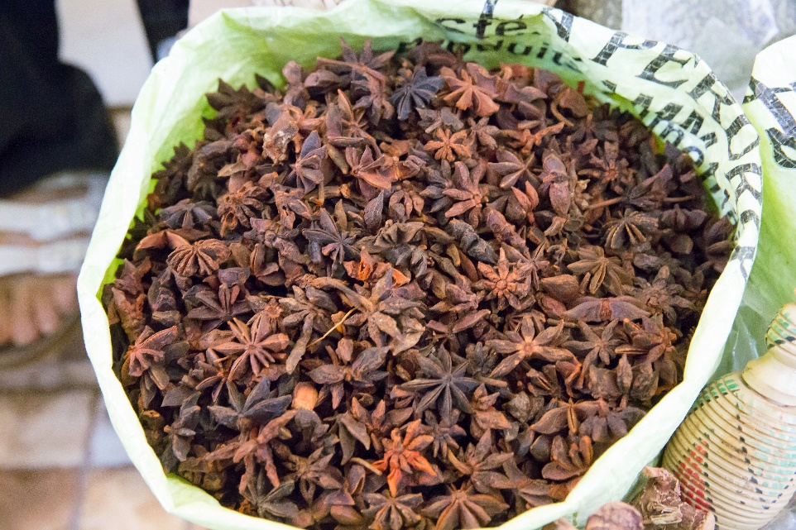
Austrobaileyales: Illium verum (Star Anise)

Slide 37
ANA Grade to Magnoliids, Monocots and Eudicots
Fusion of carpel margins rather than just sealed by a secretion
Better differentiation of flower parts.

Slide 38
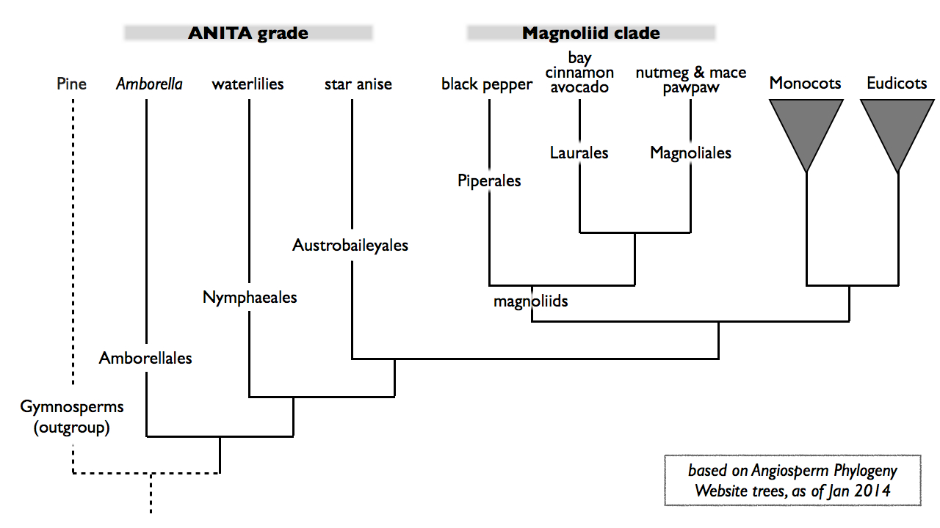
Magnoliid Clade

Slide 39
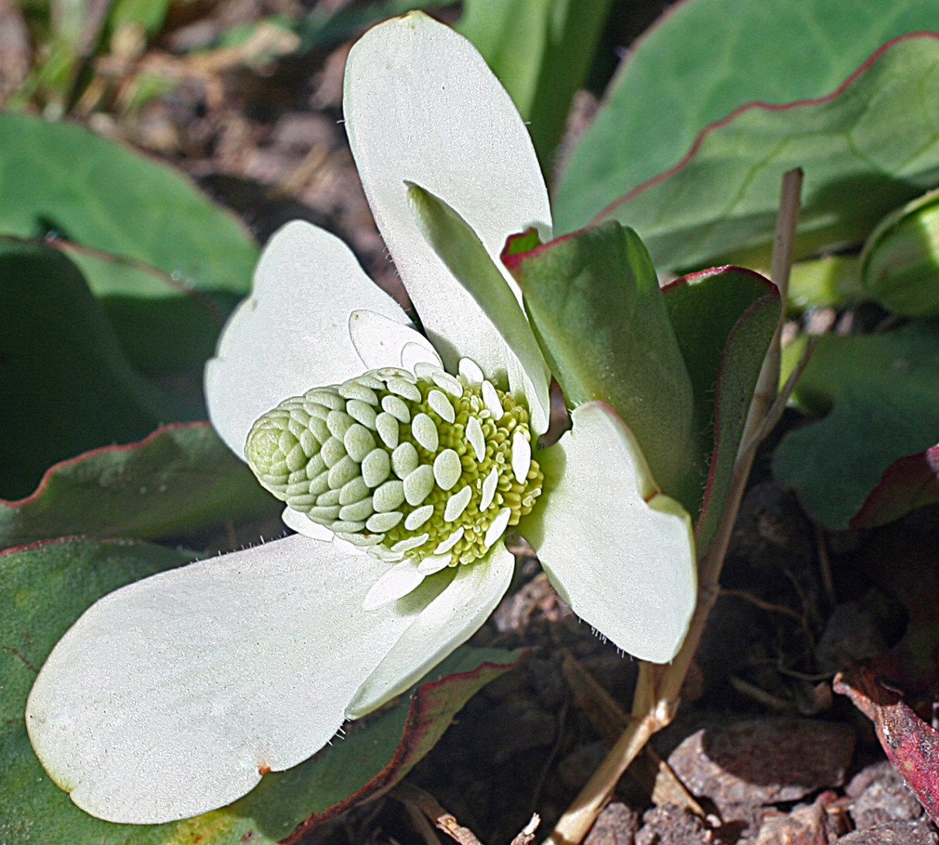
Magnoliids: Piperales: Anemopsis californica

Slide 40
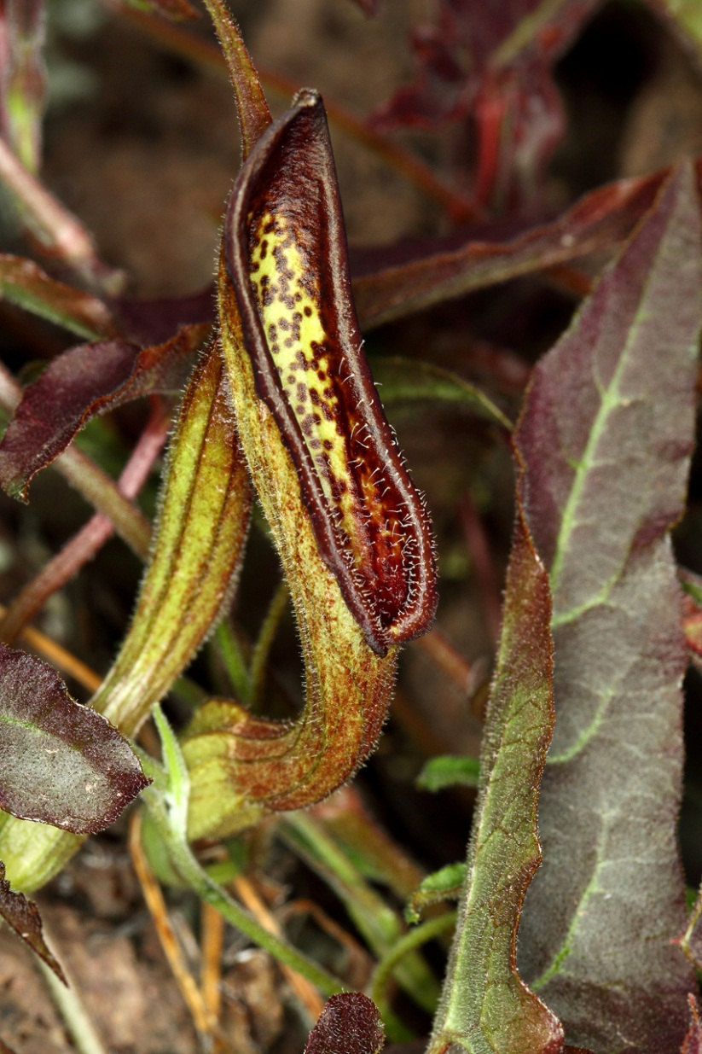
Magnoliids: Piperales: Aristolochia watsonii

Slide 41
Monocots and Eudicots
In eudicots
Feature | In monocots | In dicots
Number of parts of each flower | in threes (flowers are trimerous) | in fours or fives (tetramerous or pentamerous)
Number of furrows or pores in pollen | one | three
Number of cotyledons (leaves in the seed) | one | two
Arrangement of vascular bundles in the stem | scattered | in concentric circles
Roots | are adventitious | develop from the radicle
Arrangement of major leaf veins | parallel | reticulate
Feature | In monocots | In dicots
Number of parts of each flower | in threes (flowers are trimerous) | in fours or fives (tetramerous or pentamerous)
Number of furrows or pores in pollen | one | three
Number of cotyledons (leaves in the seed) | one | two
Arrangement of vascular bundles in the stem | scattered | in concentric circles
Roots | are adventitious | develop from the radicle
Arrangement of major leaf veins | parallel | reticulate

Slide 42
Monocots
One leaf at the first node of the embryo (cotyledon)
Scattered vascular bundles
Loss of vascular cambium
Parallel leaf venation
Flower parts in threes
Monosulcate pollen
Probably predated the origin of the clade

Slide 43
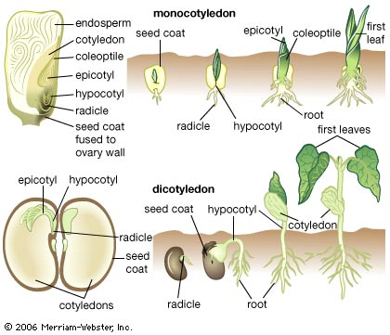
Cotyledons

Slide 44
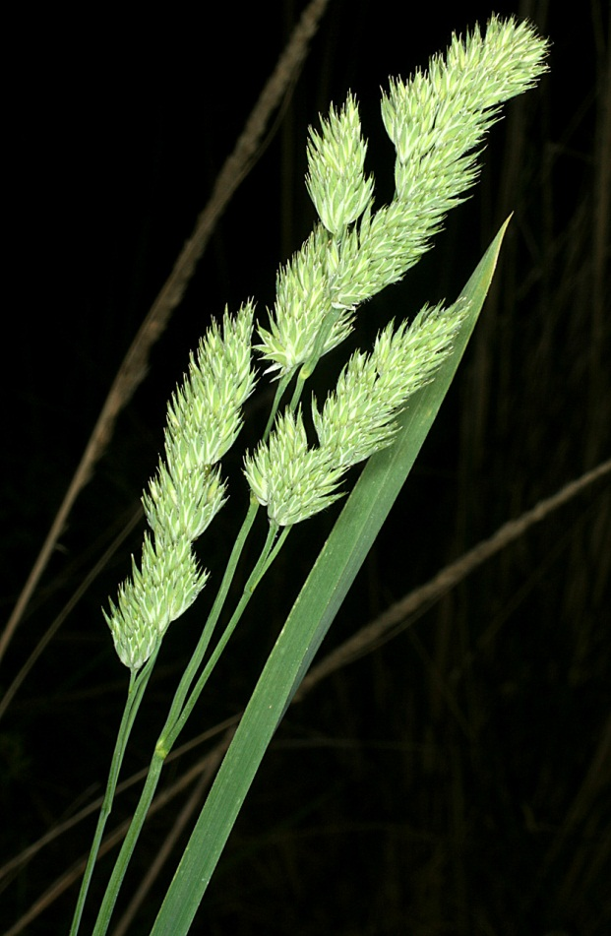
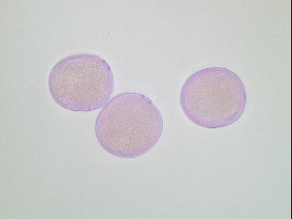
Dactylis glomerata
Monoporate pollen
Growth habit

Slide 45
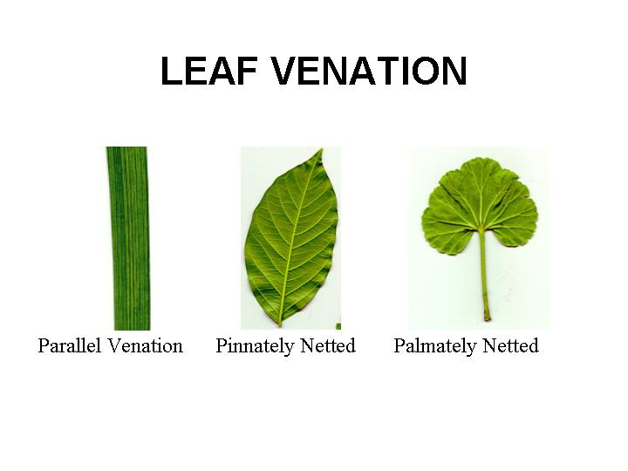
Monocot– Grass blade

Slide 46
Monocots: Scattered Vascular Bundles

Slide 47

Dichelostemma capitatum

Slide 48

Poaceae– the Grasses

Slide 49
Eudicots
Two leaves at the first node of the embryo (cotyledons)
Tricolpate pollen (or modifications thereof)
Flower parts in 4s or 5s
Non parallel venation
Retention of vascular cambium

Slide 50


Taraxacum officinale
Triporate pollen
Growth habit

Slide 51
Eudicots

Slide 52
Eudicots: Vascular Cambium

Slide 53

Chaetopappa ericoides

